Slide 1
Rose Park Golf Course
Presented by:
Jairus Anderson
Utah State University
Jairus.Anderson@aggiemail.usu.edu
Dr. Rosenberg
12/9/2020
Notes:
Hello, My name is Jairus Anderson and I will be presenting today about Rose Park Golf Course and the best use to use the budget of 100,000

Slide 2
Introduction
History
Daylight average per Month
Short Term Fix
Problem
Cost
Benefits
Constraints
Notes:
With the time changing daily,
Items that can change
Labor
Maintained
Time
Weather
Population
Ethnicity
Income
Age
National Golf Foundation defines a golfer as an individual age 6 or older, who play at least one round.
Core golfers are defined as adults 18 or older, who has played 8 – 24 rounds per year.
The term avid golfer is used for those golfers who play more than 24 rounds per year
The average golf participation rate of 18-34 years In the late 1980 was 13.5 vs 10.8% in the late 2000.
Also, currently 68% of all rounds played by those over the age of 43.
The challenge the game of golf faces is not only attracting new players, but also curbing the attrition among the golfer base. Because of demographics and situational factors, less than 54% of men and 27% of women introduced to the game continue to play after five years.
What could be some solutions?
Short term fixes
Definition of a round
When you play a around of golf, have you played 9 or 18 holes. In a golf course, you have the option of playing 9 or 18 holes. Normally, 18 is consider a full round. In this study, we will assume that a round is a person has played 18 holes. So for example, in the month of June of 2019 there was 6,157 round. that means that 6157 people has played 18 holes. Among the 6157 rounds, there could have been 1 person playing 9 holes and other playing 9 hole, which would in turn be 1 full round.

Slide 3







History of Salt Lake City Golf
Notes:
Salt Lake City oversees 6 golf course: Bonneville Forest Dale, Glendale, Mountain Dell, Nibley Park and Rose Park Golf Course
Golf course in the Salt Lake area are defunding city golf course due to the lack of water. The city uses 430 million gallons per year to water the courses and the general fund doesn’t cover golf.
My problem would be to solve the water dilemma in the Salt Lake City area.
I understand that 2 of the golf courses have closed. My job would be to save the rest of the course from closing in finding a way to save the golf course, by allocating water recourses for the golf course. Maximize irrigation on the golf courses and cost per round for the city.

Slide 4
Notes:
The presentation and report will only discuss Rose Park Golf Course.
18-holes - Built in 1957 with approximately 156 acres. Built with Culinary watering system
Switch to secondary watering system in 2018.

Slide 5
Daylight Average Per Month
Notes:
Average Monthly Daylight
Tee times every 10 mins – in one hour, you can have 6 tee times- in a tee time, you can have a max of 4 players. Therefore, theoretically, you can have 24 rounds in one hour
Other Constrictions not noted
Bad weather days – Further research

Slide 6

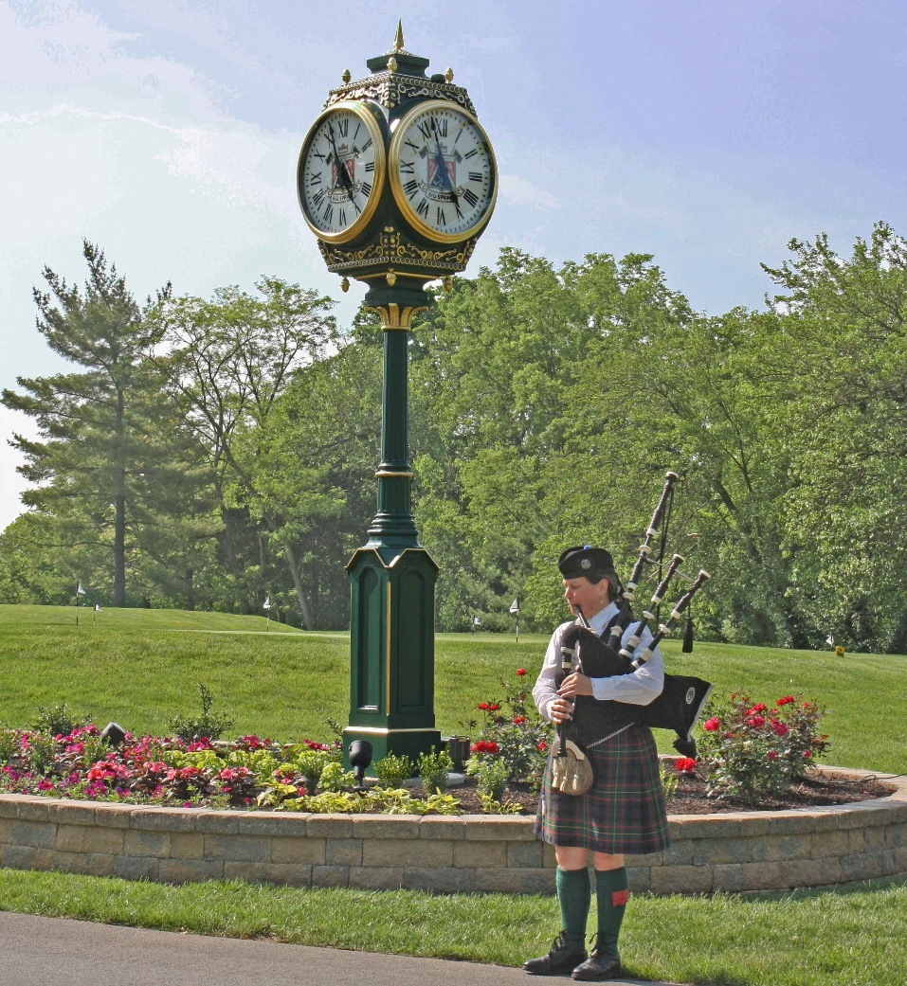
Time
Notes:
Time
Crating more opportunities for alternative forms of play(stableford scoring, among families, scrambles, reward pace of play, emphasize range programs for the severely time-compressed

Slide 7
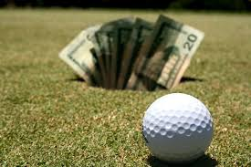

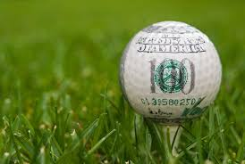
Money
Notes:
Money
Find creative way to make frequency more affordable(don’t discount, but pay for volume: offer couple or family rates; ofer season passes only on a restrictedbasis during the slowest playing times, usually weekdays from noon to 3) also, aducate the aspirational golfers; encourage them to practice more with the lat4est equipment. Keep in mind the statistic reported by the National Golf Foundation that half of golfers who have quit cite money reasons

Slide 8
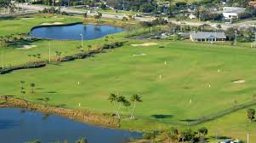
Skill
Notes:
Skill
Facilities should focus on playable options with multiple tees, easier pin positions, and eliminating those elements of penal architecture found within their courses. Course renovations should emphasize fun over difficulty
At one point in the Rose Park, the superintended of the course wanted to make the course more difficult, the struggle with increase difficulty, is found that less people would come back – by increase the “playability” of the course shows that 46% of men and 73% quick golf due to cost and difficult to play

Slide 9
Marketing VS Irrigation
$100,000 where to spend it
2016 44,534 rounds were played
2016 needed 22,450 rounds to break even
Daylight constraints or playable times – 83,663 rounds – 44,534 = 39,129 rounds
According to Business of Golf of the rounds, 50% therefore, 19, 565 due to time and practicality
Notes:
Estimated Marketing Budget would be $40,000
Irrigation cost for total reconstruction $2.75Mil
Understanding the cost/round for Marketing and Irrigation

Slide 10
Comparing Rounds from 2016-2019
Notes:
August – Tournaments – my Max Available times are an average for the month due to daylight
Can’t have someone Tee off when it gets dark, the cut off would be 2 hours before dark in order to finish in time.
Example – in March, there is an average daylight of 12 hours 0 mins therefore, the averalbe usable time would be 10 hours in order to count as a full round (9 holes, someone teeing off on the front nine, and than the back nine.

Slide 11
Problem Formulated

Slide 12
Recap
Rounds needed
Marketing
Replace Irrigation
Increase rounds
Notes:
Salt Lake City is willing to put $100,000 into Rose Park.
Do they market, or do they replace irrigation – total fix for 18 holes is 2.75Mill – the $100,000 would be able to replace par 3 hole
22,450 rounds to break even
Daylight constraints or playable times – 83,663 rounds – 44,534 = 39,129 rounds
According to Business of Golf of the rounds, 50% therefore, 19, 565 due to time and practicality

Slide 13
Further Evaluation
Population
Playable days
Currently assuming no snow days, or bad weather –refine
Assuming 100% Marketing – Refine
Future benefits
short term (Marketing)
Long term Irrigation
Notes:
Further Evaluation:
Population of age and ethnicity sex vs % of players already playing golf –
By knowing the population age and ethnicity the constraints will more than likely decrease the amount of rounds that can be fillable (usable)
Need to find the percent of people of a certain age group and how often they play
In 2016 population of ages 50 to 85 and over was 51,000 – rose park had 44,000 rounds play, well, how many were recurring? Trying to capture those that haven’t played
How much of a return are we really getting on marketing – not fair to say that we will be capturing 100% of the tee times needed
Look at 2017, 2018, 2019 if spending $100,000 and increasing the amount of players, and those numbers carried over, what would be the outcome for the other years

Slide 14

Questions

